Slide 1

Smart Waste Classification System
Presented by
D. Lokesh (192372216)
R. Vishwa Teja (192372109)
T. Charani Kirthi Sri (192312550)
Guided by:
Dr Krishna Kumar

Slide 2
Introduction
The Smart Waste Classification System is an automated system designed to identify and separate different types of waste, such as plastic, paper, metal, glass, and organic waste.
It uses smart technologies like sensors, cameras, Artificial Intelligence (AI), and machine learning to detect and classify waste accurately.
The system reduces manual effort, saves time, and makes waste segregation safer and more efficient.
Proper classification helps improve recycling, reduce environmental pollution, and minimize improper waste disposal.

Slide 3
Problem Statement
Improper waste segregation causes pollution and increases landfill waste.
Manual waste sorting is time-consuming, labour-intensive, and unsafe for workers.
Mixed waste makes recycling and proper disposal difficult.
There is a need for an automated system to identify and classify different waste materials.
The system aims to use AI, sensors, and cameras to improve waste segregation, recycling, and overall waste-management efficiency.

Slide 4
Objective
Develop an AI-based system to automatically classify waste into different categories.
Improve waste segregation accuracy and reduce manual effort.
Promote recycling by identifying recyclable and non-recyclable waste.
Reduce environmental pollution through proper waste management.
Provide real-time waste classification using image processing and machine learning.

Slide 5
Module 1: Waste Image Collection & Preprocessing
Collect labelled waste images from datasets such as Kaggle.
Resize and normalize images to a standard format for model training.
Remove noisy or duplicate images to improve data quality.
Split the dataset into training, validation, and testing sets.

Slide 6
Module 2: AI-Based Waste Classification
Train a deep learning model using the pre-processed waste images.
Classify waste into categories such as Plastic, Paper, Glass, Metal, Cardboard, and Trash.
Evaluate the model using accuracy, precision, and recall metrics.
Predict the waste category for new images in real time.

Slide 7
Module 3: Dashboard & Reporting
Display the predicted waste category and confidence score.
Store classification results in a database or CSV file.
Generate reports showing the number of items in each waste category.
Visualize waste statistics using charts and graphs for analysis.

Slide 8
Objective | Module | Dataset Component | How They Are Connected
Automatically classify waste using AI | Module 1: Waste Image Collection & Preprocessing | Labelled waste images (Plastic, Paper, Glass, Metal, Cardboard, Trash) | The images are collected, cleaned, resized, and prepared for training the AI model.
Improve waste segregation accuracy | Module 2: Waste Classification | Training, Validation, and Test image sets | The AI model learns from the training images and predicts the correct waste category.
Promote recycling and reduce pollution | Module 2: Waste Classification | Waste category labels | The predicted category helps users separate recyclable and non-recyclable waste correctly.
Provide real-time waste classification | Module 3: Dashboard & Reporting | Prediction results (CSV/Database) | The classified results are stored and displayed to users through a dashboard.
Generate reports for waste management | Module 3: Dashboard & Reporting | Prediction history, confidence scores, timestamps | These records are used to create charts, reports, and waste statistics.

Slide 9
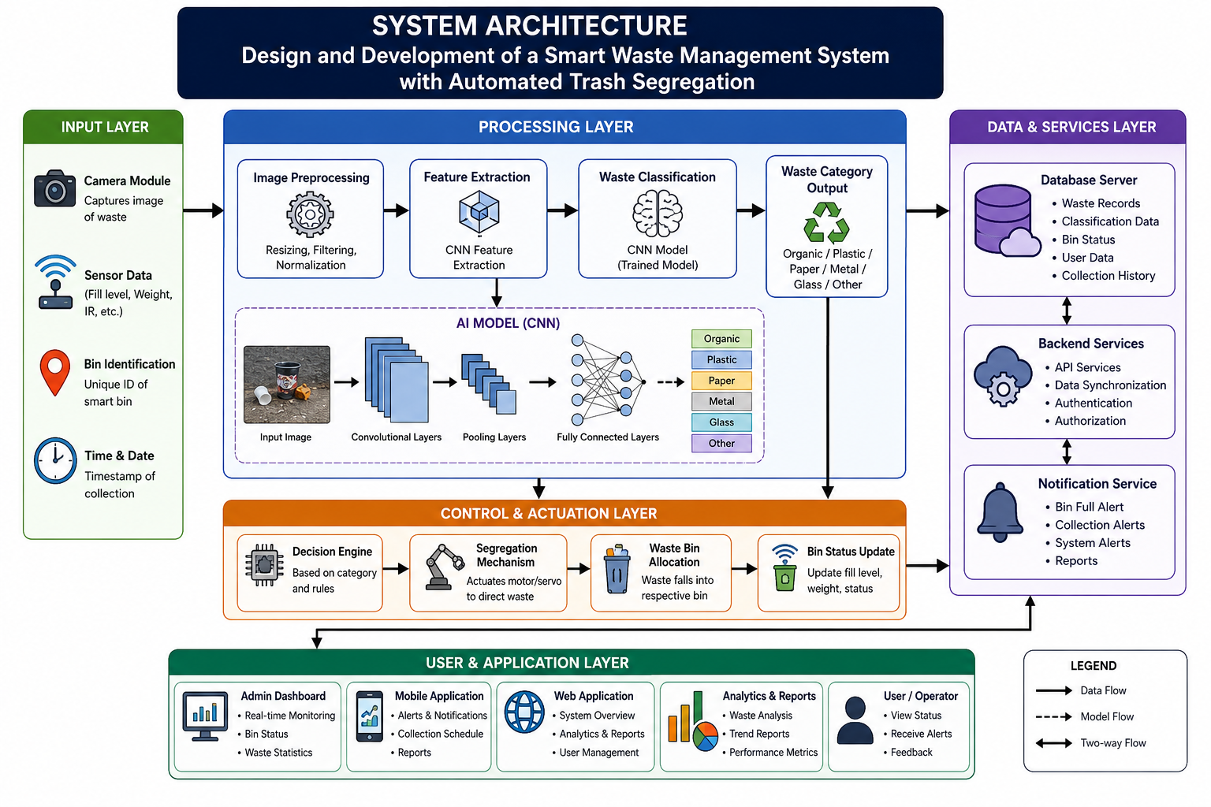

Slide 10
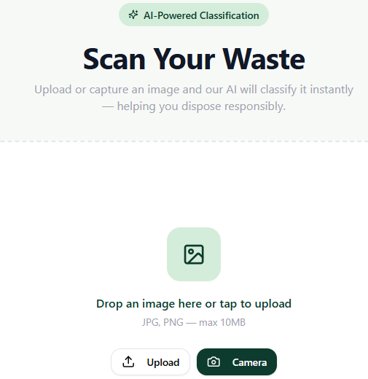
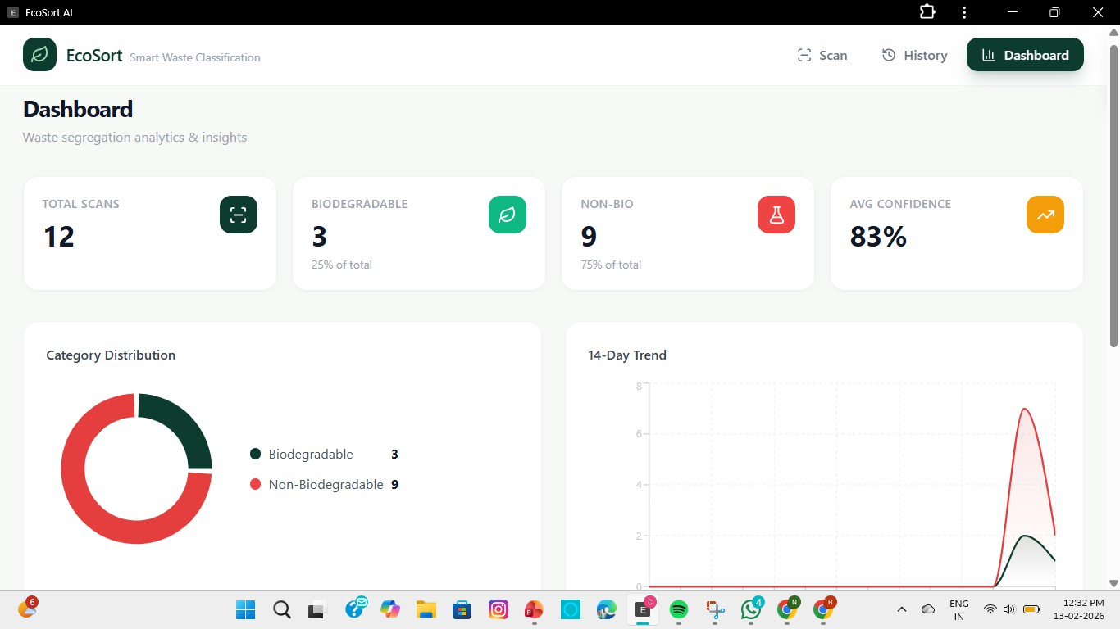
Result

Slide 11
Conclusion
The Smart Waste Classification System automates waste segregation using AI, improving accuracy and reducing manual effort.
The system promotes proper recycling and supports efficient waste management, contributing to a cleaner environment.

Slide 12


